Slide 1
Insertion Sort

Slide 2
What is Insertion Sort?
Simple sorting algorithm
Builds the final list (or array) one at a time
A type of incremental algorithm
6 5 3 1 9 7 4

Slide 3
What is Insertion Sort?
Insertion sort works similar to the sorting of playing cards in hands.
It is assumed that the first card is already sorted in the card game, and then we select an unsorted card.
If the selected unsorted card is greater than the first card, it will be placed at the right side; otherwise, it will be placed at the left side.
Similarly, all unsorted cards are taken and put in their exact place.

Slide 4
Advantages
Simple
Efficient for small data sets
One of the faster O(n^2) performance algorithms
Does not require extra memory
Low overhead • Best case is O(n)
Nearly sorted input

Slide 5
Disadvantages
Poor performance with large lists
Expensive with many elements
Not as quick as merge sort or quicksort
Worst case is O(n^2)
Input Array/List in reverse order

Slide 6
Insertion Sort Runtimes
Best case: O(n)
Average case: O(n^2)
Worst case: O(n^2)

Slide 7
So how does it work?
By Insertion, of course!

Slide 8
ALGORITHM
Step 1 - If the element is the first element, assume that it is already sorted. Return 1.
Step2 - Pick the next element, and store it separately in a key.
Step3 - Now, compare the key with all elements in the sorted array.
Step 4 - If the element in the sorted array is smaller than the current element, then move to the next element. Else, shift greater elements in the array towards the right.
Step 5 - Insert the value.
Step 6 - Repeat until the array is sorted.

Slide 9
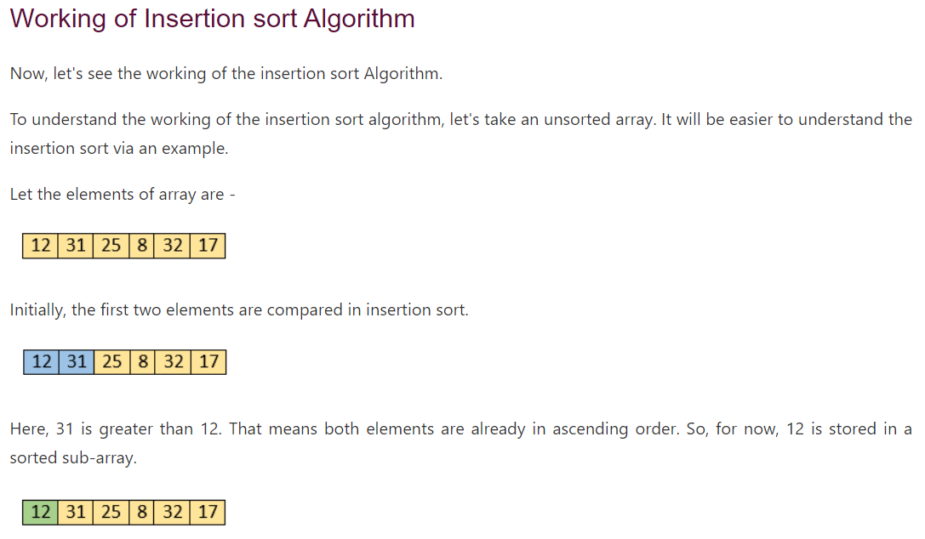

Slide 10
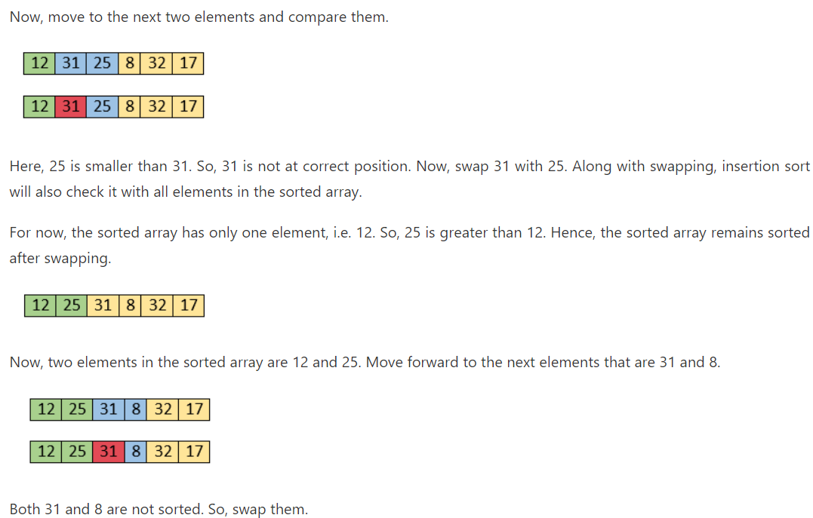

Slide 11
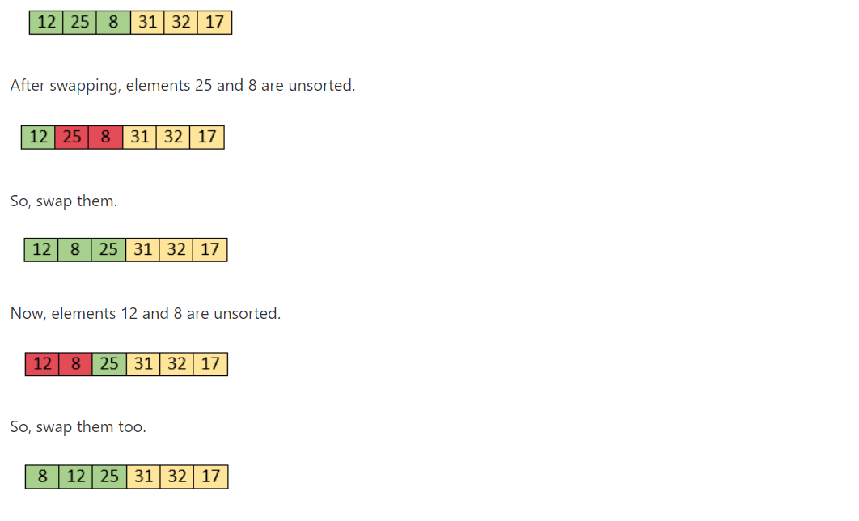

Slide 12
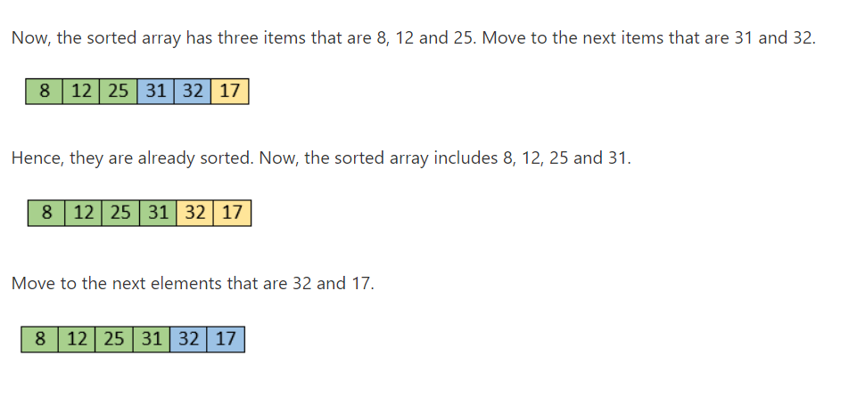

Slide 13
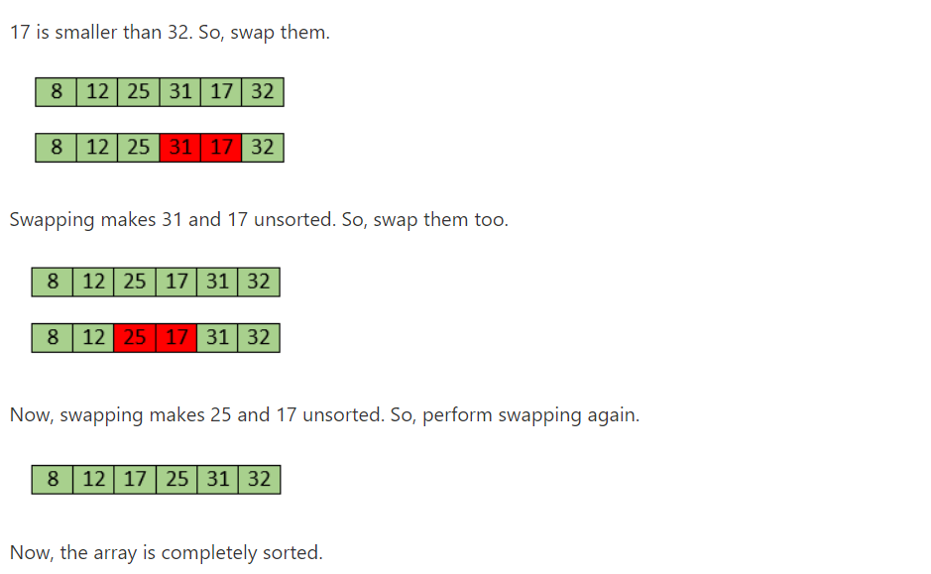

Slide 14
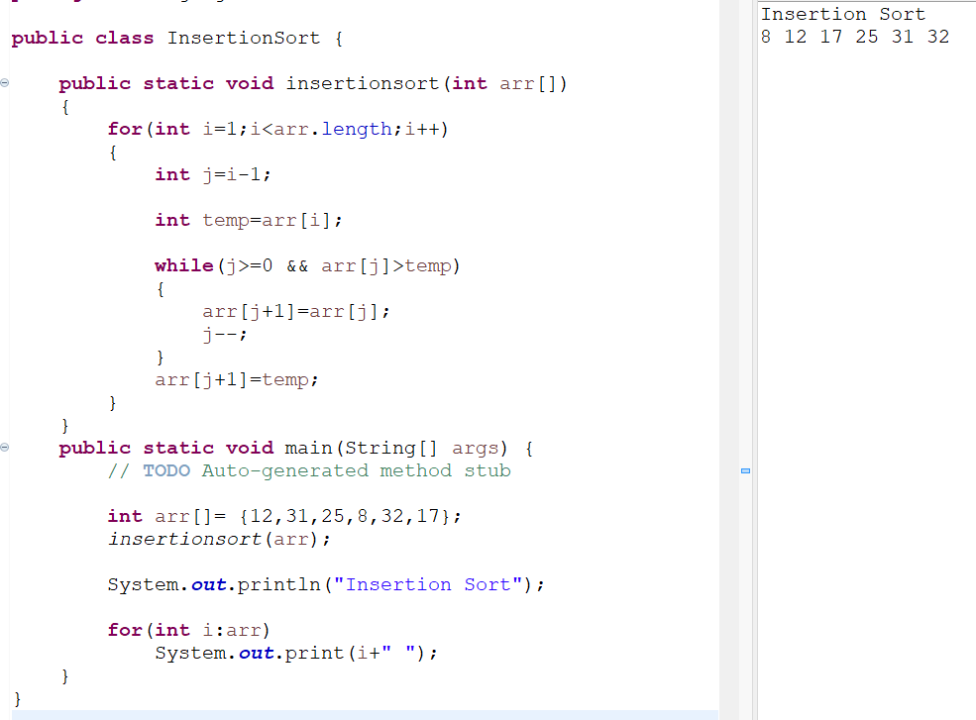
Implementation

Slide 15
Thank You

